Slide 1
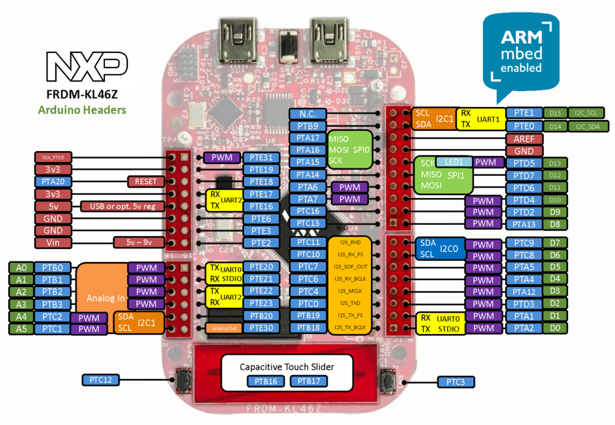
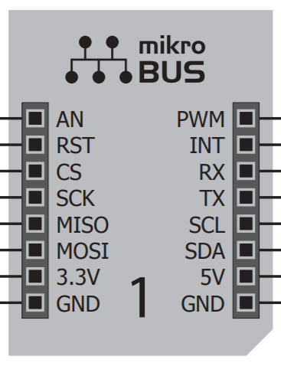
Challenges
mikroBUS |  | KL-46Z |  | PIN NAME | STATES
Spi | 4 | Spi | 2 | SCK MOSI MISO SS/CS | Shared Shared Shared Unique
I2C | 4 | I2C | 2 | SCL SDA | Shared Unique
Analog | 4 | Analog | 6 | AN | Unique
PWM | 4 | PWM | 6 | PWN | Unique
Interrupts | 4 | Interrupts | 6 | IN | Unique

Slide 2
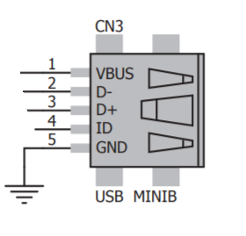
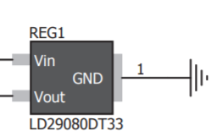

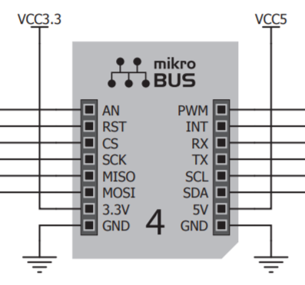
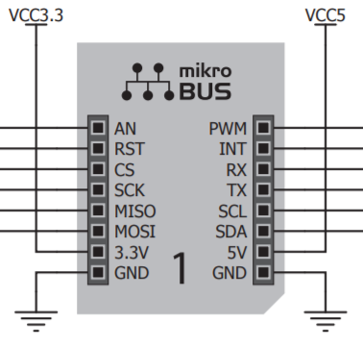

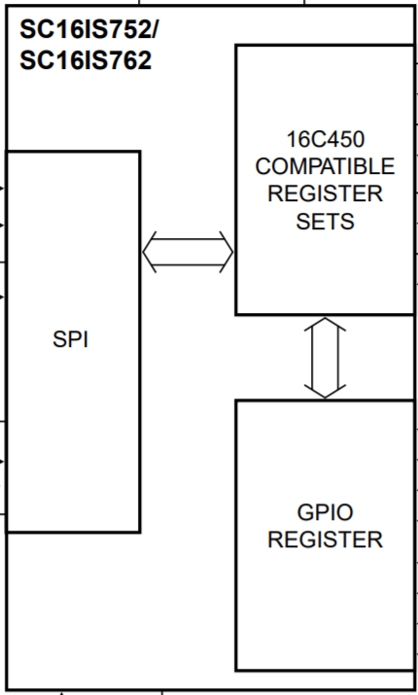



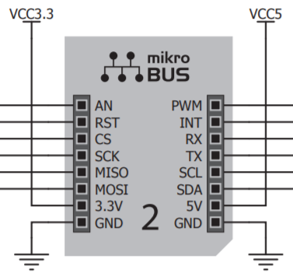
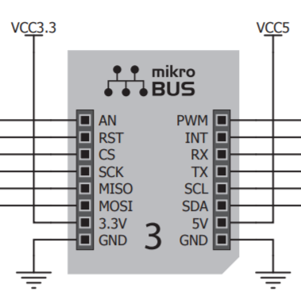
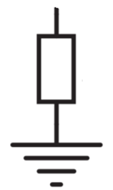
Power
Input
Voltage Regulator
2 channels 3.3V&5V
SPI
SPI TO UART
I2C
PWM
ANALOG
INTERRUPTER
RESET
Test Point
Reset Button
Convert
SPI to UART
J1
RX_1
RX_4
J4
TX_1
TX_4
PWM_1
SS_0
RX_2
RX_3
PWM_2
SS_1
TX_2
TX_3
AN_1
PWM_3
SS_2
AN_2
PWM_4
SS_4
AN_3
AN_4
ENCO_3
MOSI_1
ENCO_2
MISO_1
ENCO_1
CS_4
GND
SCK_1
SCK_0
2:4
CS_3
v5v
MOSI_0
CS_2
v3v
MISO_0
CS_1
SDA
SCL
J2
Decoder 2 to 4
Select Slaves
J3
R1
SPI_SC_1
PTA14
R2
SPI_SC_2
Reset Button
INT_1
8:3
PTA6
INT_2
PTA7
INT_3
Test Point
INT_4
Priority Encoder 8 to 3
Interrupter

Slide 3
SPI: Serial Peripheral Interface
Separate clock and data lines, along with a select line to choose the device you wish to talk to.
Master
Slave
CSCK
CSCK
MOSI
MOSI
FRDM KL46Z
MISO
MISO
Click
SS
SS
GND

Slide 4
The SPI devices disconnect their MISO pins when they are not selected
Each slave will need a separate SS line
SLAVE 1
SLAVE 2
SLAVE n
SCK
MOSI
MISO
SS
SCK
MOSI
MISO
SS
SCK
MOSI
MISO
SS
Master
SCK
MOSI
MISO
SS _ 1
SS _ 2
SS _ n

Slide 5
I2C
minimize number of pin and send more that 8 bits data
You can have up to 127 devices on a same bus
R1 and R2 are depended on slave and master voltage
Master
Slaves (n)
R1
Clock (SCL)
Data (SDA)
FRDM KL46Z
R2
Click

Slide 6
Slave 1
Slave 1
Slave n
CLICK 1
CLICK 1
CLICK n
SCL SDA
SCL SDA
SCL SDA
Master
R1
Clock (SCL)
Data (SDA)
R2

Slide 7
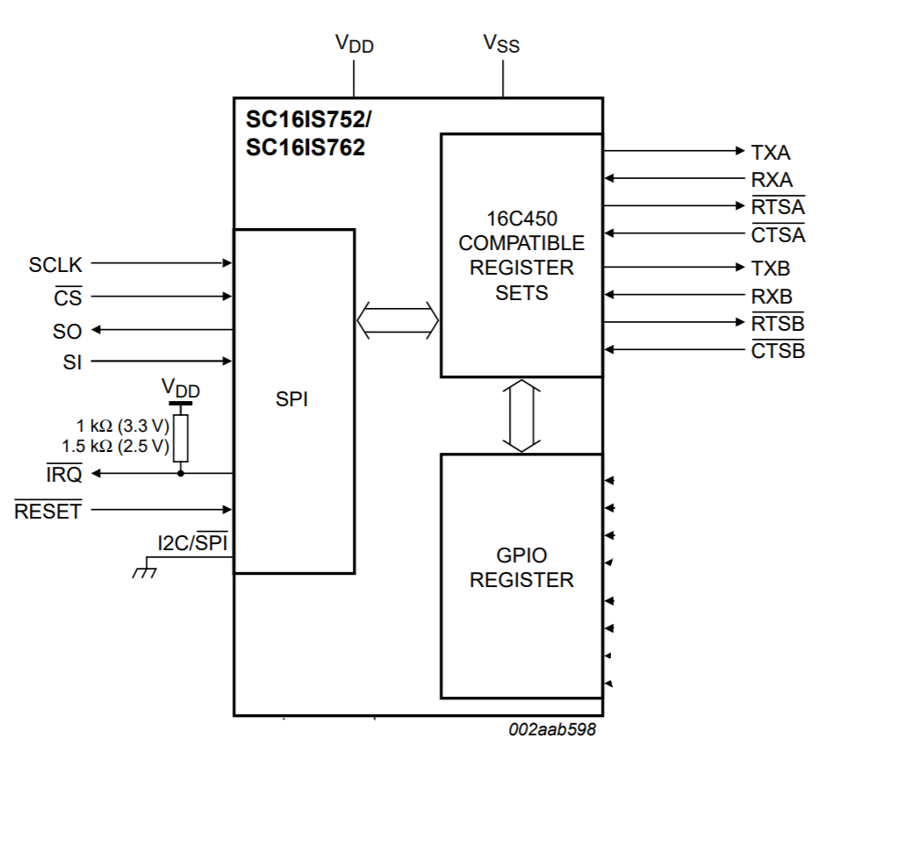
SC16IS752; SC16IS762 Dual UART with I2C-bus/SPI interface
This chip enables seamless protocol conversion from I2C-bus/SPI to RS-232/RS-485 and is fully bidirectional.
SC16IS752 supports 4 Mbit/s maximum SPI clock speed  SC16IS762 supports 15 Mbit/s maximum SPI clock speed
3.3 V or 2.5 V operation
CTSA: UART clear to send (active LOW), channel A. A logic 0 (LOW) on the CTSA pin indicates the modem or data set is ready to accept transmit data from the SC16IS752/SC16IS762
RTSA: UART request to send (active LOW), channel A. A logic 0 on the RTSA pin indicates the transmitter has data ready and waiting to send

Slide 8
PWM: Pulse Width Modulation
A series of pulses generate a rectangular waveform which looks something like the following.
Each pulse is characterized by two parameters: period (T) and duty cycle (D)
T may be any length of time
D may be any value in the range 0 ≤ D ≤ 1
The pulse width is D*T.
Pulse width modulation allows for the automatic generation of a pulse train with specified period and duty cycle/pulse width
D*T
T

Slide 9
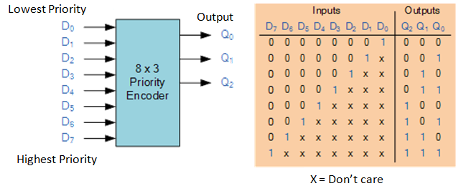
Encoder Logic

Slide 10
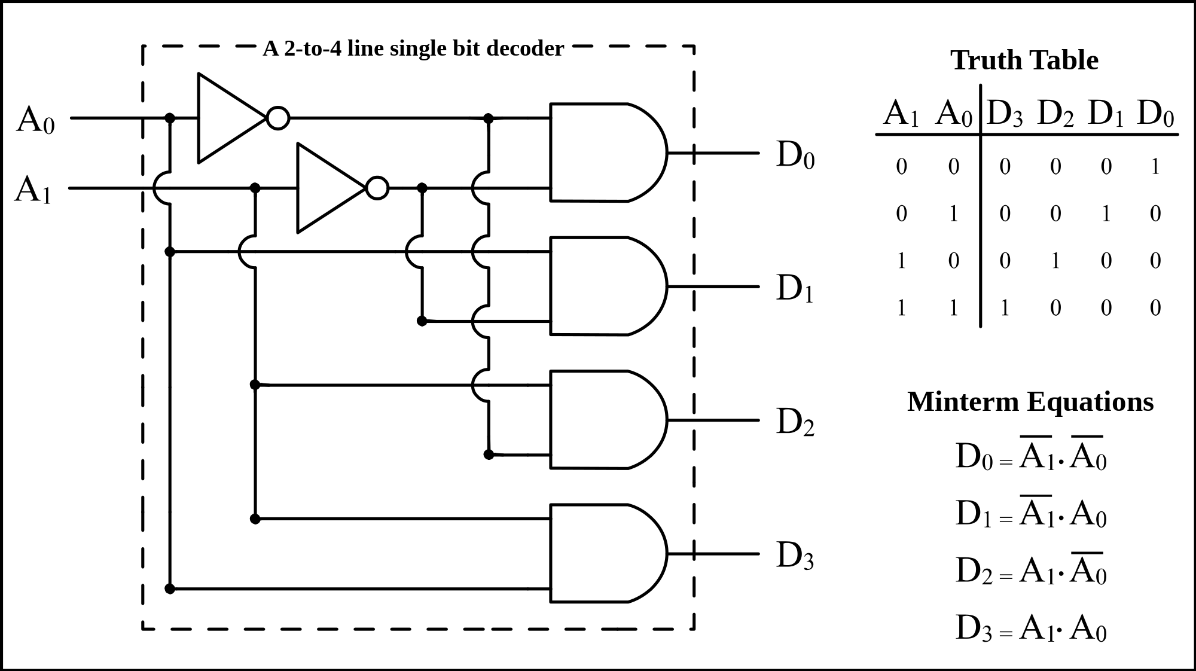
Decoder Logic

